Slide 1
Lifespan Development
Chapter Review

Slide 2
Piaget’s Theory
Sensorimotor: what is object permanence?
Preoperational: can use symbols, can play “pretend”; egocentric, lack of conservation.
Concrete operational: can count, measure, add and subtract; can use simple logical operations only for real and concrete objects.
Formal operational: can engage in hypothetical thinking; can understand abstract ideas.

Slide 3
Kohlberg’s moral development theory
Preconventional: mainly concerned with avoiding punishment
Conventional: morality consists of following conventions such as duty to the family, marriage vows, and country.
Postconventional: based on personal standard or universal principles of justice, equality and respect for human life.

Slide 4
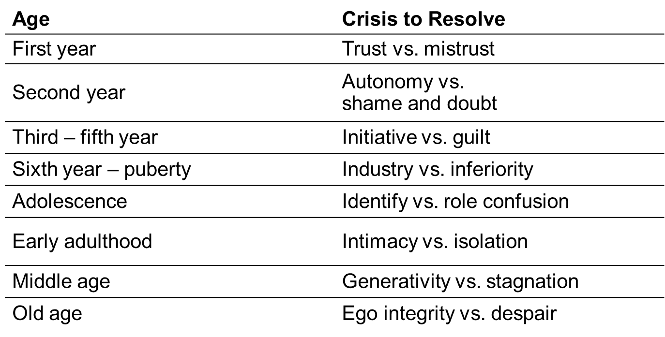
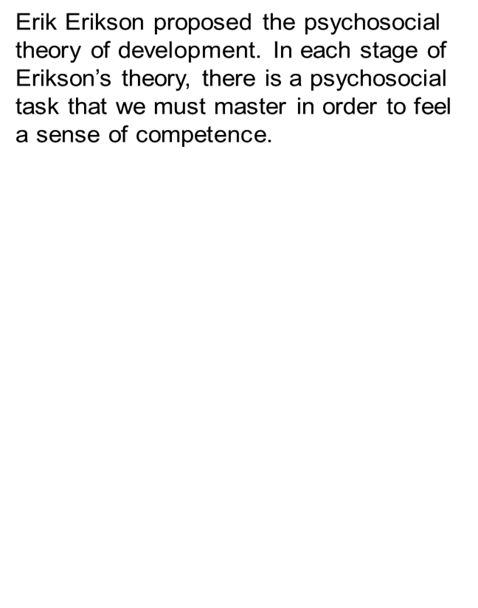
Erikson’s stages of psychosocial development: adolescence and early adulthood

Slide 5
Stages of prenatal development and prenatal risks
Zygote, embryo, fetus
Teratogens such as tobacco, alcohol, and cocaine can cause birth defects, especially during the embryonic stage (critical period).

Slide 6
Reflexes
Unlearned, automatic responses to external stimuli.
Examples: rooting, grasping, sucking.

Slide 7
Infancy to Childhood
The size of the brain increases significantly
Infants as young as three months old can understand how the physical world works. (See Baillargeon’s study)
3-5 years old: Theory of Mind

Slide 8
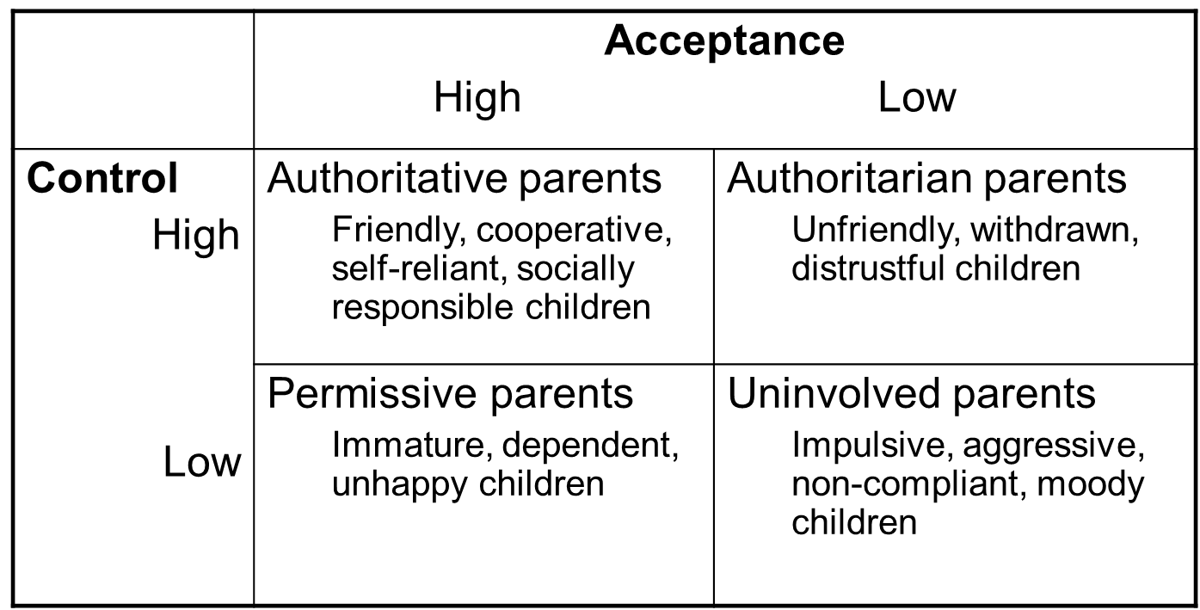
Parenting styles

Slide 9
Attachment
Secure attachment
Insecure attachment:
Avoidant
Resistant
disorganized

Slide 10
Adolescence
Rates of physical development vary widely among teenagers:
Early maturing boys: Greater risk for substance abuse and early sexual activity.
Early maturing girls: Greater risk for depression, substance abuse, and eating disorder.
Late blooming boys: higher risk for depression and conflict with parents, more likely to be bullied.

Slide 11
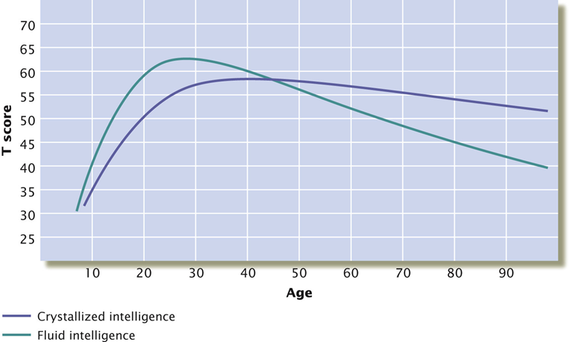
Adulthood
Early & middle adulthood: Cognitive abilities improve
More complex and adaptive
More dialectical
Late adulthood:
Noticeable declines in fluid intelligence (information processing, reasoning)

